Slide 1
Web Application Development ISCG7420 Introduction to Web Development
School of Computing, Electrical and Applied Technology

Slide 2
Outlines
Django forms
Generic views
Testing
Static folder
Customize the admin form

Slide 3
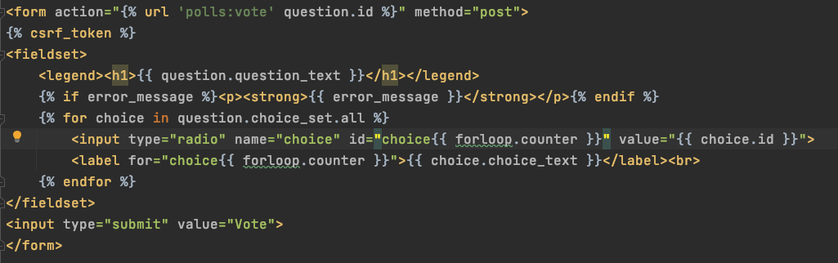
Django Form
Update polls/detail.html inside template folder
Think about this

Slide 4
Notes on form
action → form to go
method → request
csrf_token → Cross site request forgery
A CSRF token is a unique, secret, unpredictable value that is generated by the server-side application and transmitted to the client in such a way that it is included in a subsequent HTTP request made by the client.
forloop.counter → count loop times

Slide 5
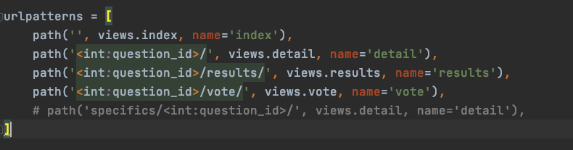
Register Vote to your urls
Polls/urls.py

Slide 6
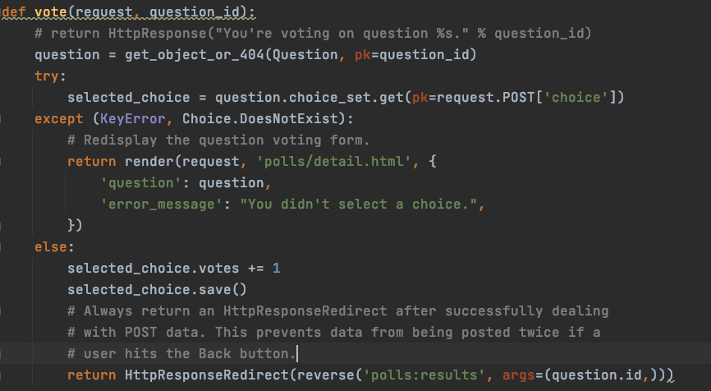
Update vote() in view
Polls/views.py

Slide 7
Request
request.POST is a dictionary-like object that lets you access submitted data by key name. In this case, request.POST['choice'] returns the ID of the selected choice, as a string. request.POST values are always strings.
Note that Django also provides request.GET for accessing GET data in the same way – but we’re explicitly using request.POST in our code, to ensure that data is only altered via a POST call.
request.POST['choice'] will raise KeyError if choice wasn’t provided in POST data. The above code checks for KeyError and redisplays the question form with an error message if choice isn’t given.

Slide 8
HttpResponseRedirect
HttpResponseRedirect takes a single argument: the URL to which the user will be redirected
reverse() helps avoid having to hardcode a URL in the view function. It is given the name of the view that we want to pass control to and the variable portion of the URL pattern that points to that view.
'/polls/3/results/’ will be the redirect url in this case

Slide 9
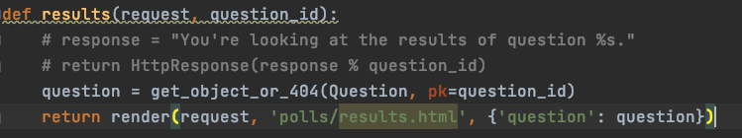
Update result view
polls/views

Slide 10
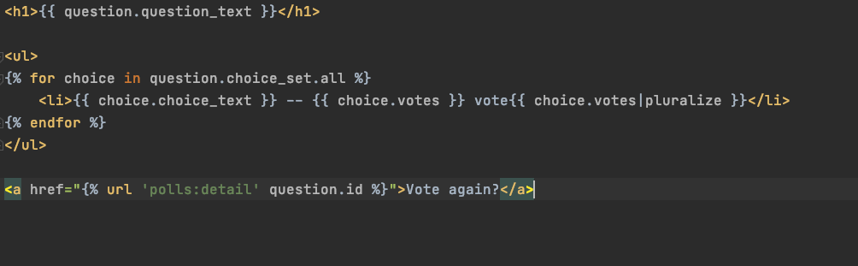
Create a result view
polls/results.html inside template

Slide 11
Generic views
Less code is better
Convert the URLconf.
Delete some of the old, unneeded views.
Introduce new views based on Django’s generic views.

Slide 12
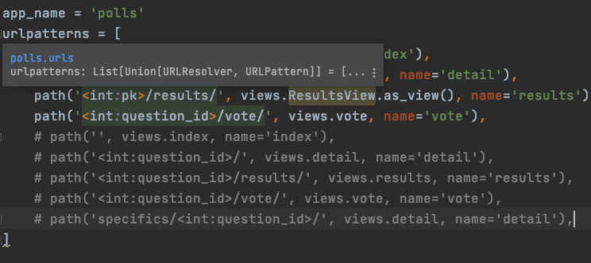
Change urls inside polls

Slide 13
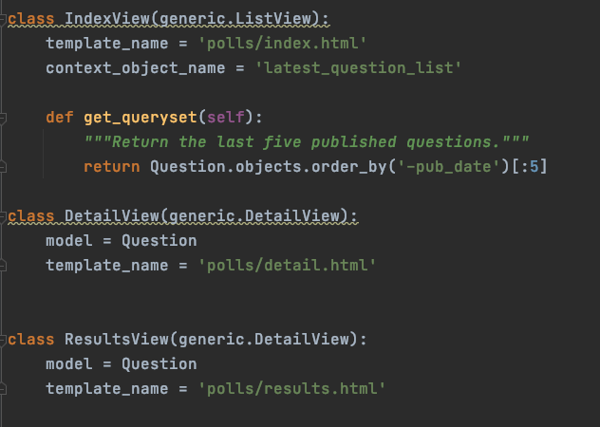
Changes in view file

Slide 14
Automated tests
Tests will save you time
Tests don’t just identify problems, they prevent them
Tests make your code more attractive
Tests help teams work together

Slide 15
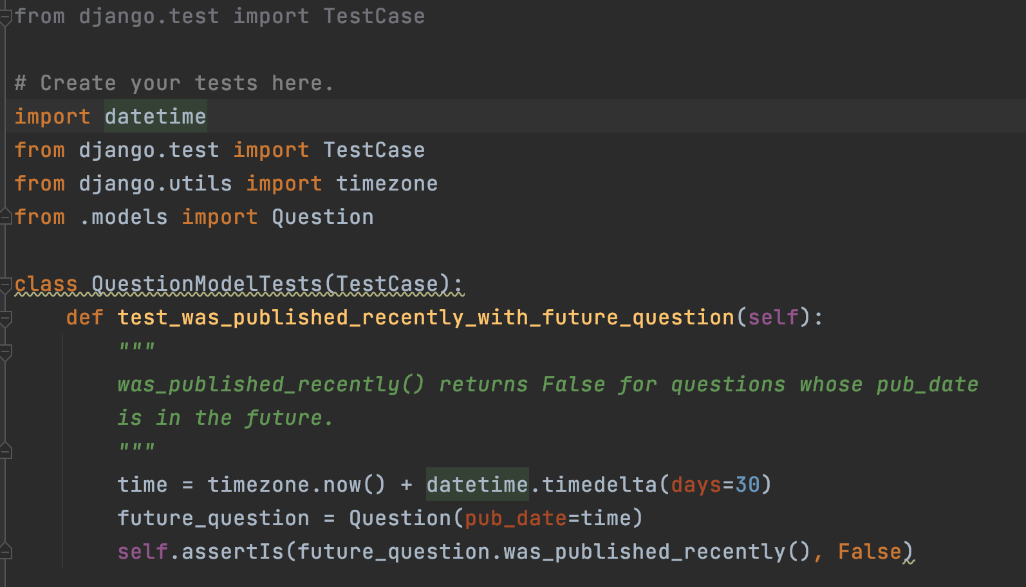
Create a test to expose the bug
tests.py

Slide 16
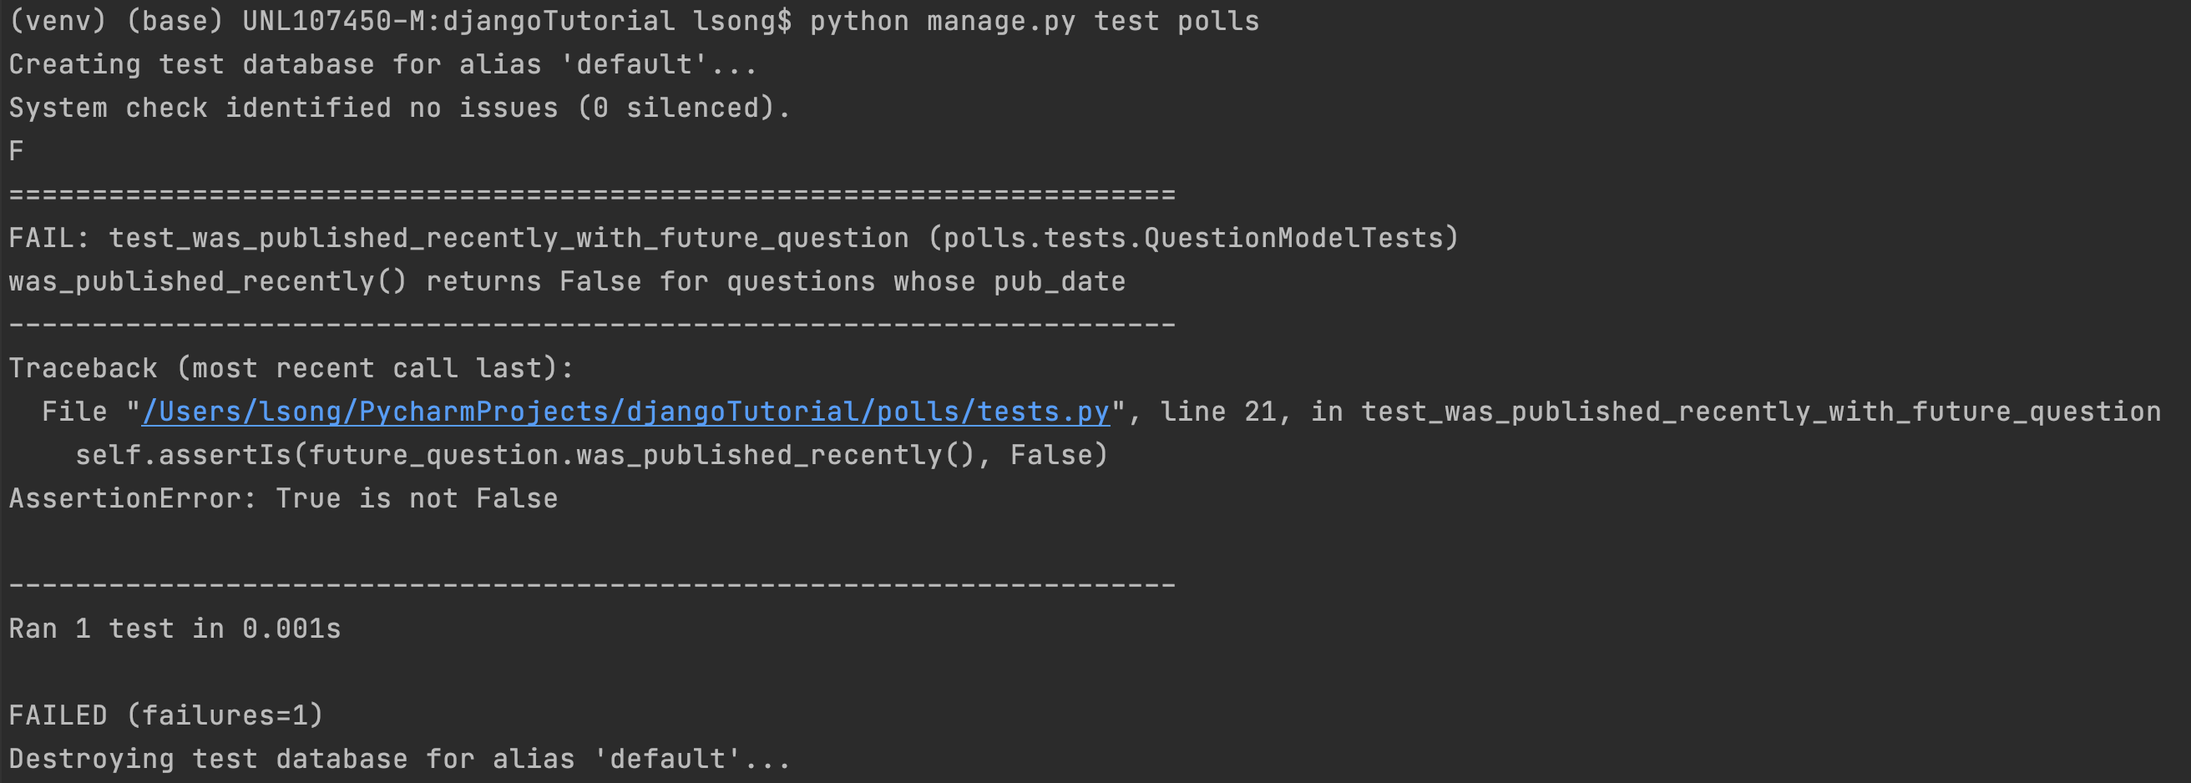
Running tests
python manage.py test polls

Slide 17
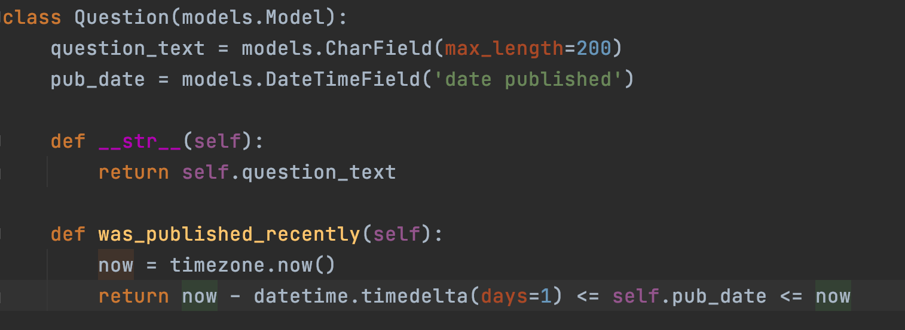
Fix the function for current publishing
In Model question
Run the test again please

Slide 18
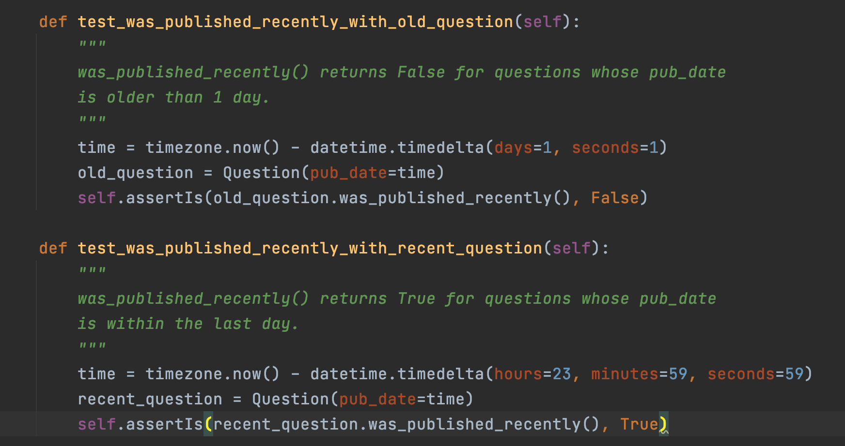
More comprehensive tests

Slide 19
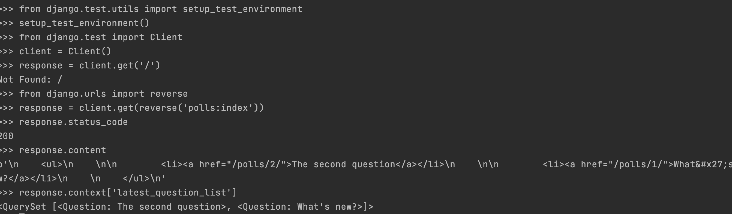
Test view

Slide 20
Improving our view
__gte → greater than equal
__gt → greater than
__lt → less than
__lte → less than equal
__startswith → startwith letter

Slide 21
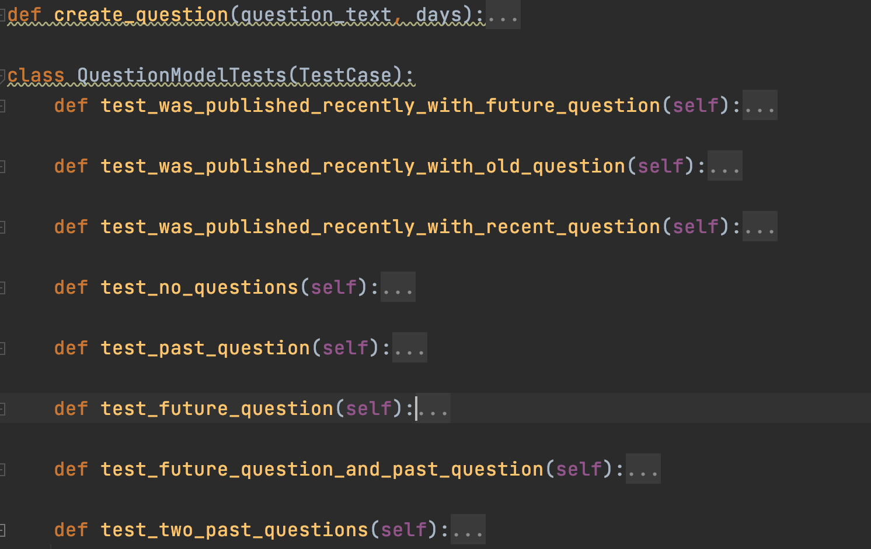
Create more test

Slide 22
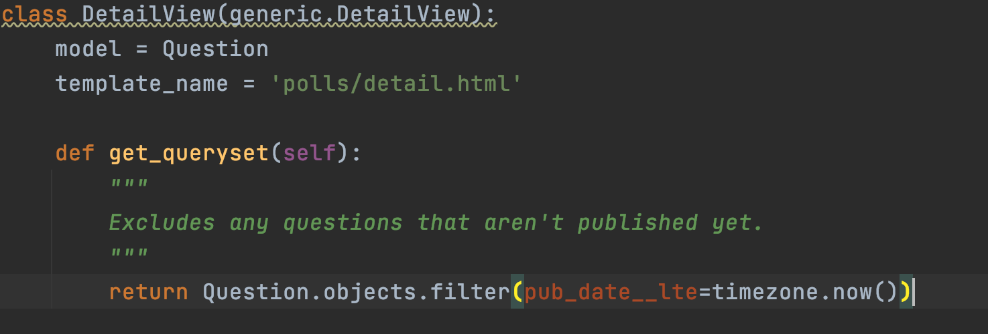
Testing the DetailView

Slide 23
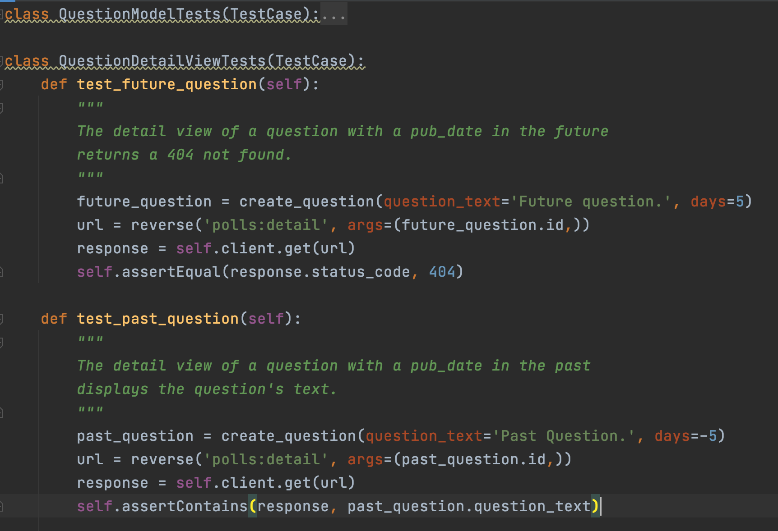
Testing the DetailView

Slide 24
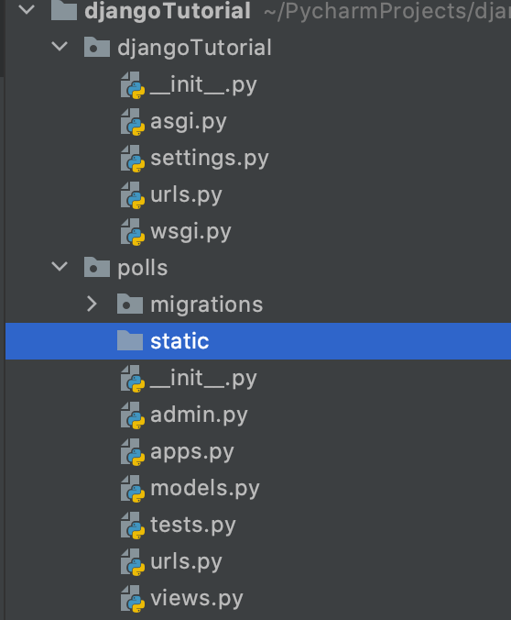
Static folder
create a directory called static in your polls

Slide 25
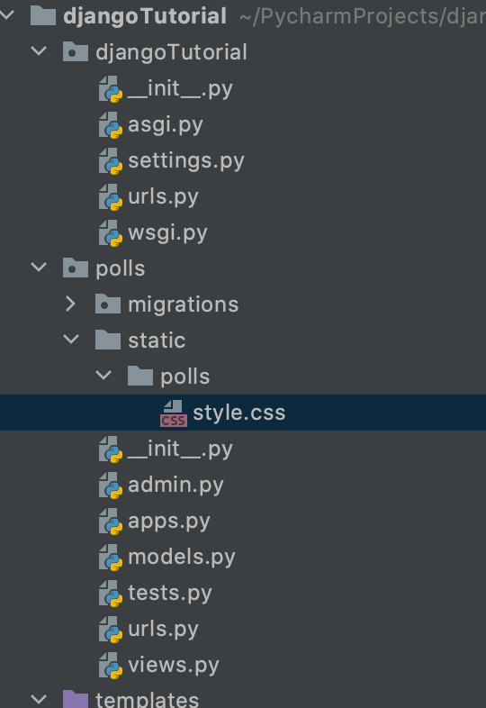
Static css file
Polls
Static
Polls
style.css

Slide 26
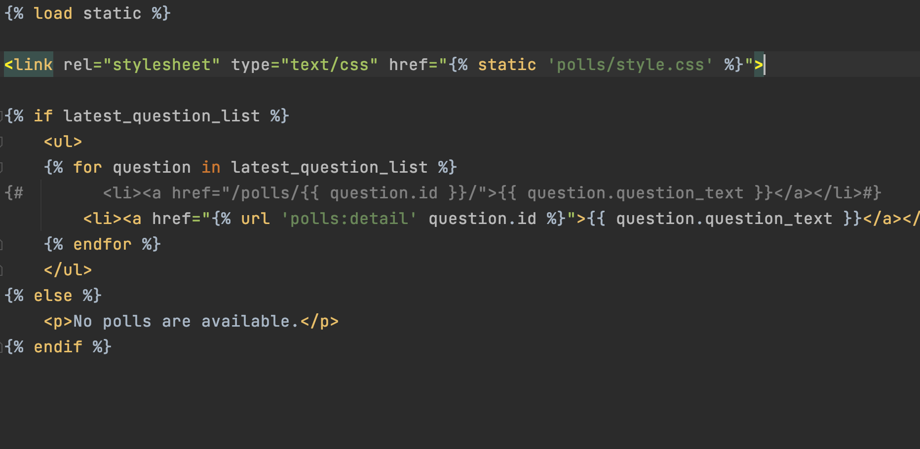
Link css to your index.html
polls/templates/polls/index.html:

Slide 27
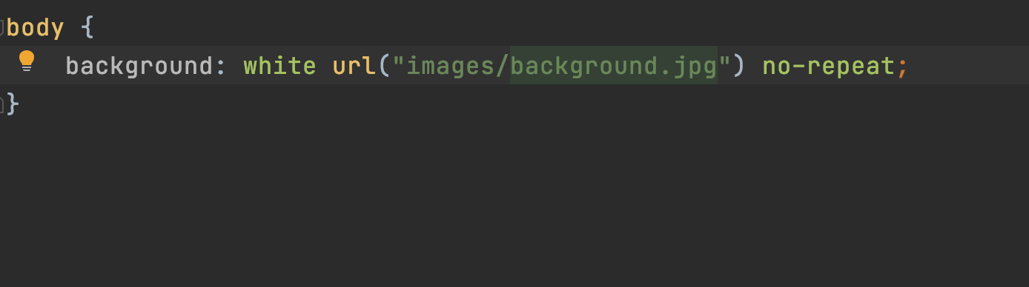
Adding a background-image
Create an images subdirectory in the polls/static/polls/ directory
Put a picture in
In css file, add

Slide 28
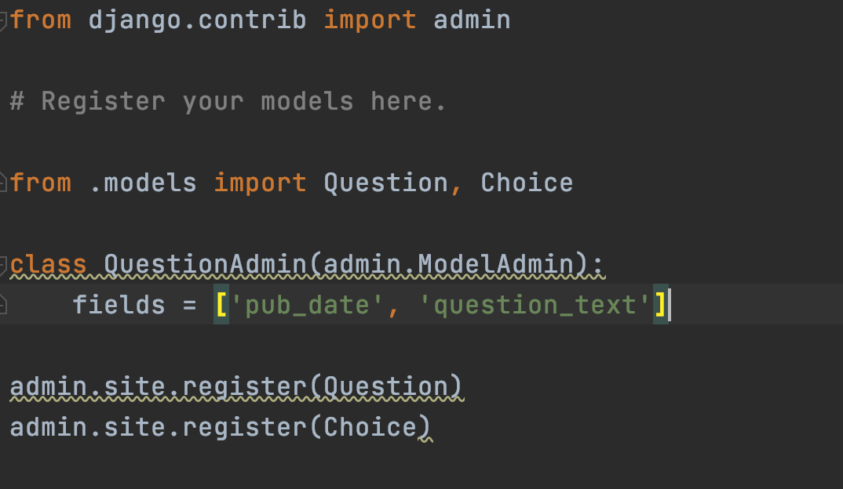
Customize the admin form
polls/admin.py

Slide 29
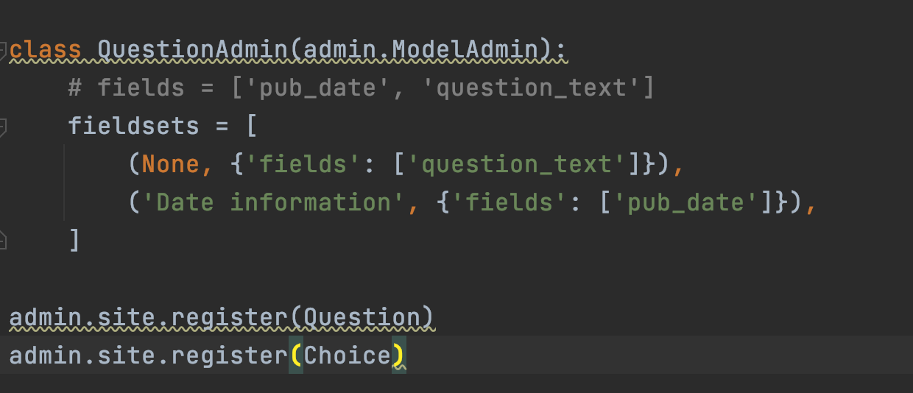
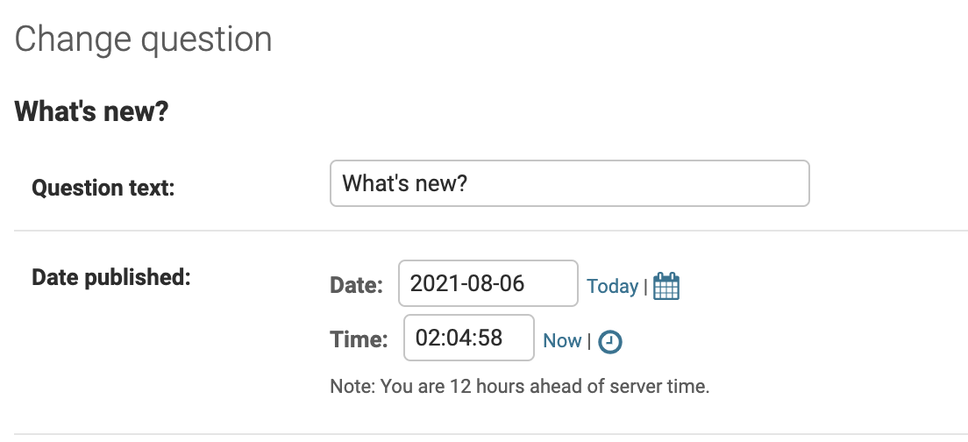
Fieldsets

Slide 30
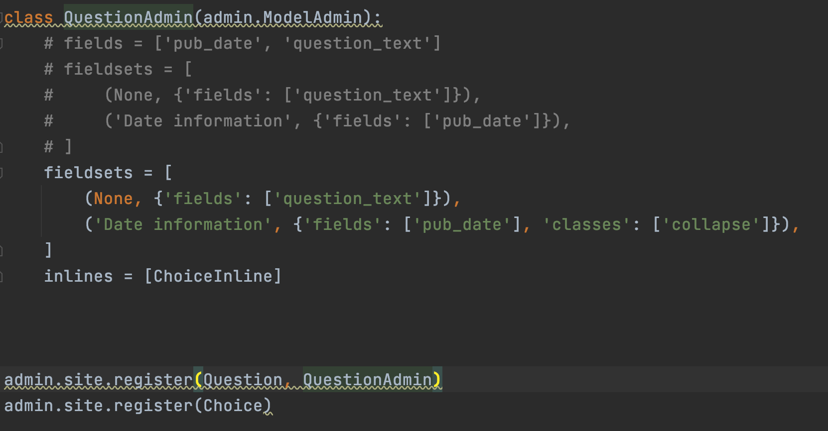
Add choices below question

Slide 31
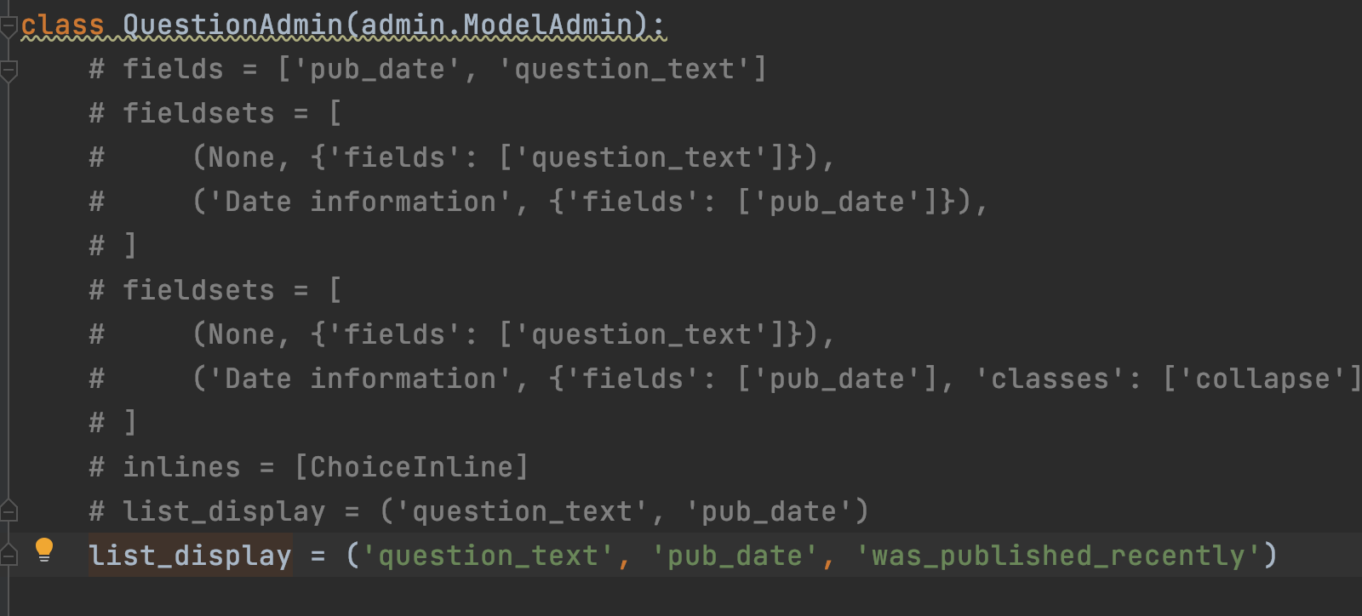
Customize the admin change list

Slide 32
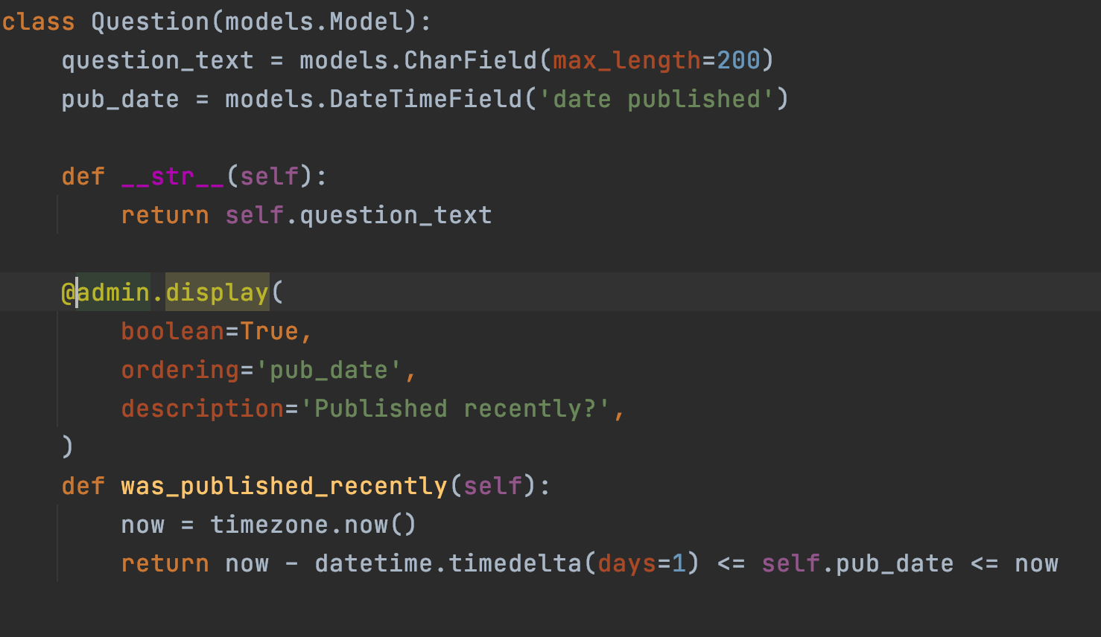
display() decorator
polls/models.py

Slide 33
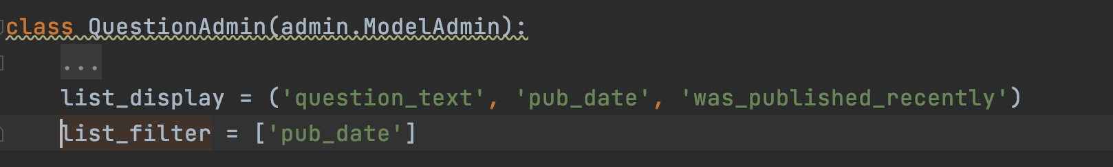
list_filter
polls/admin.py
Then you will have filter on right

Slide 34
Customize the admin look and feel
settings.py
python -c "import django; print(django.__path__)"
Find your Django folder
Create a directory called admin inside templates
Copy base_site.html from your django/contrib/admin/templates to template/admin

Slide 35
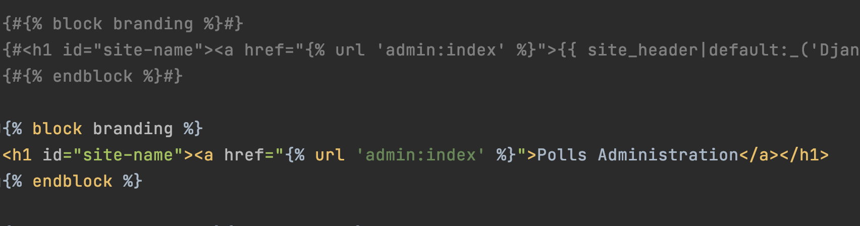
Edit base_site.html

